Slide 1
Binary image processing
Morphological Operations
Image segmentation

Slide 2
Binary images
Black and white images of logical type.
By convention, white is the foreground, black is the background.
Logical operations and set theory can be applied:
Intersection, with AND operator
Union, with OR operator
Inversion, with NOT operator
Difference, with MINUS operator
Binary images are a result of many image segmentation operations.
It is useful to detect and label connected components in a binary image.

Slide 3
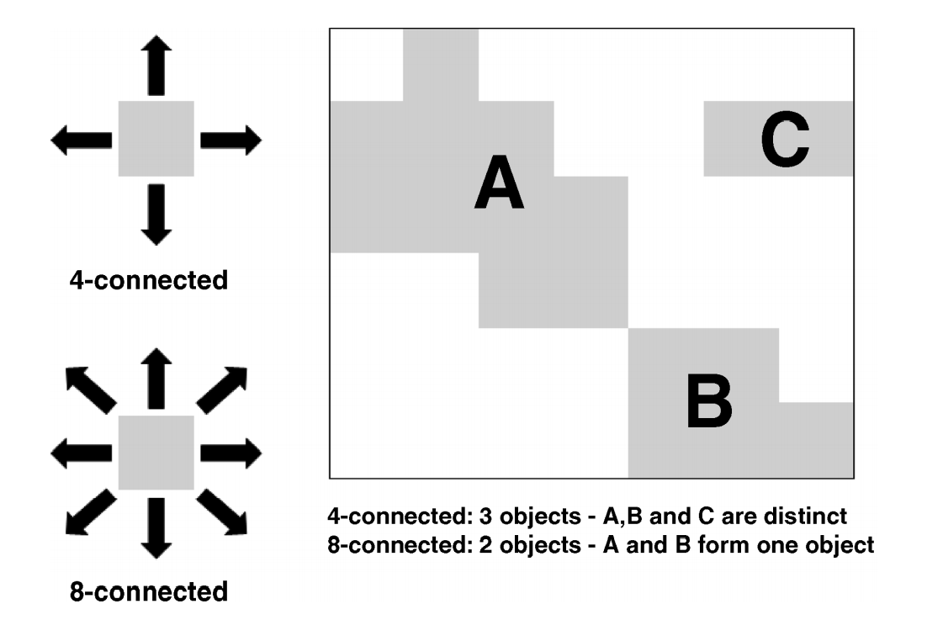
Connected components
Contiguous regions of white pixels.
Also called “blobs”.
4-pixel adjaceny or 8-pixel adjacency.
Labeling: assigning different numbers to different connected components.
Matlab functions: bwconncomp, labelmatrix, label2rgb

Slide 4
Region properties
Compute various statistics regarding shape, size and location for each blob:
Area, perimeter, centroid, standard deviation, bounding box, circularity, etc.
Count the number of blobs.
Matlab function : regionprops
The number of blobs is equal to the size of the structure array returned by regionprops function.
Or equal to the maximum label number in the label image.

Slide 5
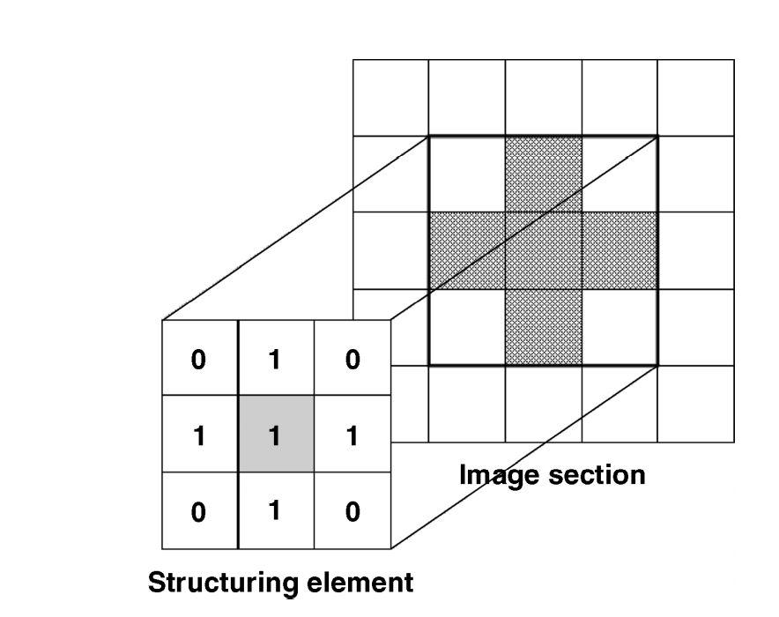
Morphological operations
In BW images, a morphological operation outputs a modified BW image.
Through a morphological operation, we decide which pixels remain foreground and which remain background.
Essential to a morphological operation is the structuring element.
In Matlab, the coordinates of the structuring element centre pixel are defined by the expression floor((size (nhood) þ 1)/2), where nhood is the structuring element.
Notes:
The structuring element is the entity which determines exactly which image pixels surrounding the given foregound/background pixel must be considered in order to make the decision to change its value or not. The particular choice of structuring element is central to morphological processing.
A structuring element is a rectangular array of pixels containing the values either 1 or 0 (akin to a small binary image

Slide 6
Dilation and erosion
To perform erosion of a binary image, we successively place the centre pixel of the structuring element on each foreground pixel (value 1). If any of the neighbourhood pixels are background pixels (value 0), then the foreground pixel is switched to background.
To perform dilation of a binary image, we successively place the centre pixel of the structuring element on each background pixel. If any of the neighbourhood pixels are foreground pixels (value 1), then the background pixel is switched to foreground.
Opening : erosion followed by dilation
Closing: dilation followed by erosion

Slide 7
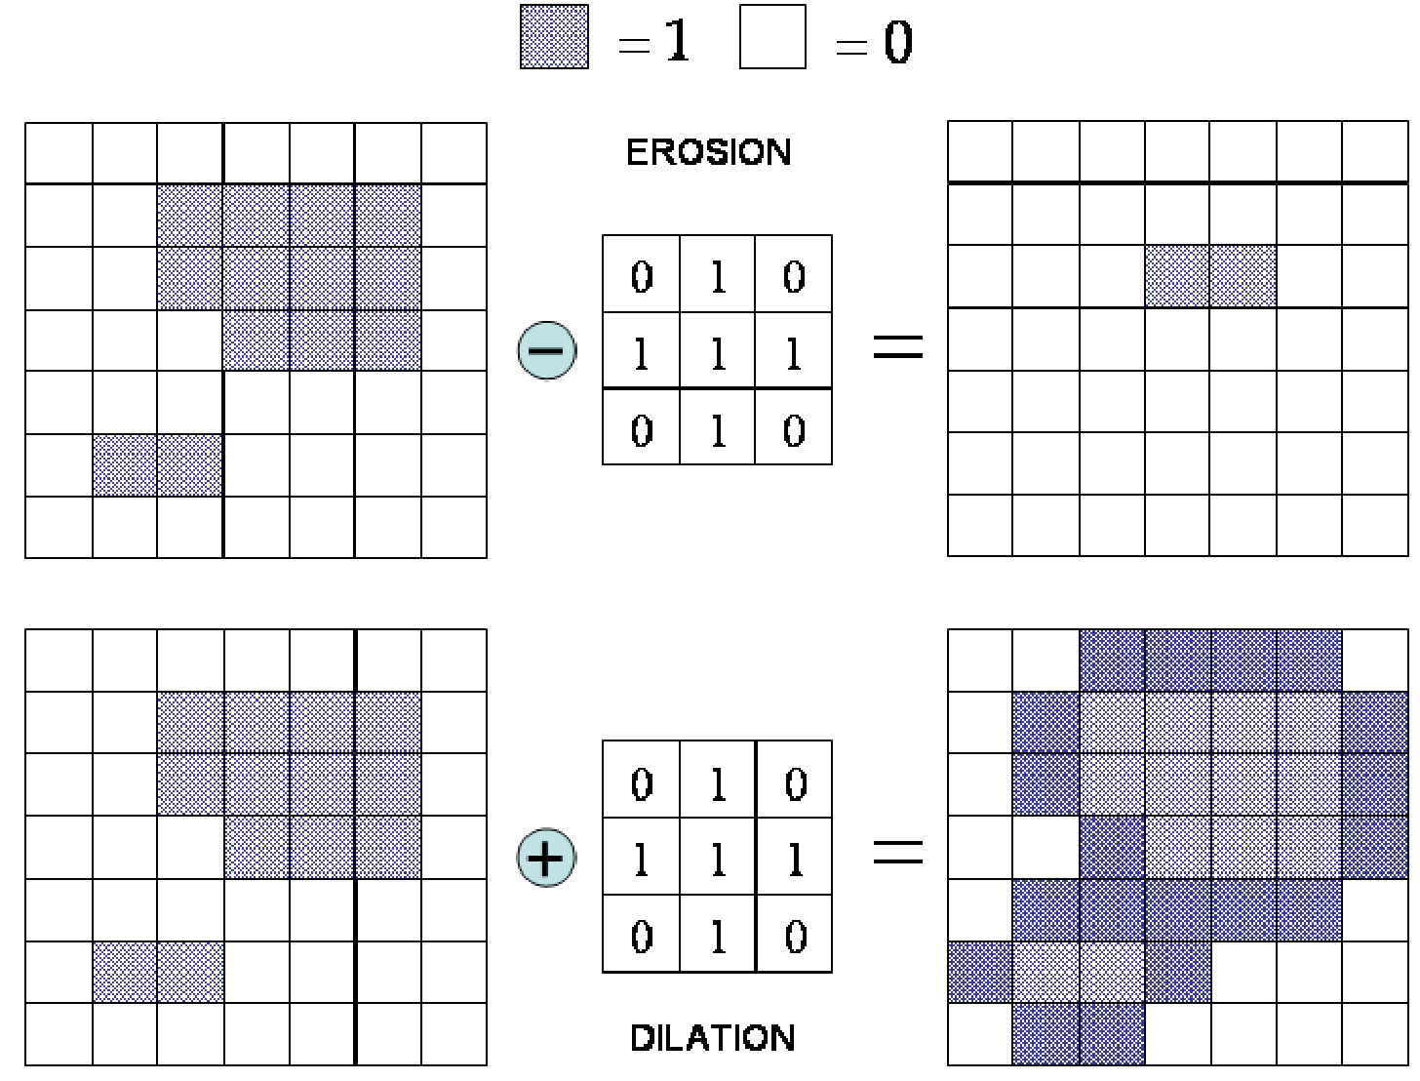
Notes:
Erosion: a foreground pixel only remains a foreground pixel if the 1s in the structuring element (in this example, a cross) are wholly contained within the image foreground. If not, it becomes a background pixel. Dilation: a background pixel only remains a background pixel if the 1s in the structuring element are wholly contained within the image background. If not, it becomes a foreground pixel.
The mechanics of dilation and erosion operate in a very similar way to the convolution kernels employed in spatial filtering. The structuring element slides over the image so that its centre pixel successively lies on top of each foreground or background pixel as appropriate. The new value of each image pixel then depends on the values of the pixels in the neighbourhood defined by the structuring element.
There is a powerful and simple way of visualizing the outcome of applying erosion or dilation to an image. For erosion, consider all those locations within the image at which the structuring element can be placed and still remain wholly contained within the image foreground. Only the pixels at these positions will survive the erosion and thus constitute the eroded image. We can consider dilation in an entirely analogous way; namely, we consider those locations at which the structuring element can be placed so as to remain entirely within the image background. Only these pixels will remain background pixels after the dilation and form the dilated image.
Note that whenever the structuring element goes over the boundary of the image, we only consider that part of the neighbourhood that lies within the boundary of the image.

Slide 8
Application
Erosion
Removes small isolated features,
Breaks apart thin, joining regions in a feature
Reduces the size of solid objects by ‘eroding’ them at the boundaries.
Dilation
Broadens and thickening narrow regions
Grows a feature around its edges.
Matlab functions: imerode, imdilate

Slide 9
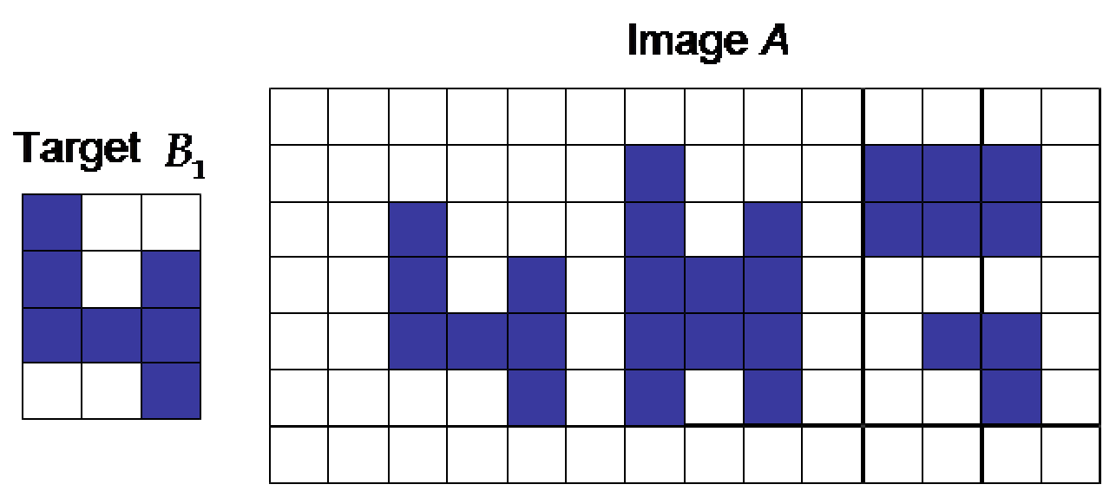
Hit-or-miss transformation
A basic tool for shape detection.
The pattern is characterized by a structuring element.
Searching for the locations inside the image of the correct combination of foreground and background pixels.
Applications: finding fiducial and calibration target in an image, QR code detection, barcode detection

Slide 10
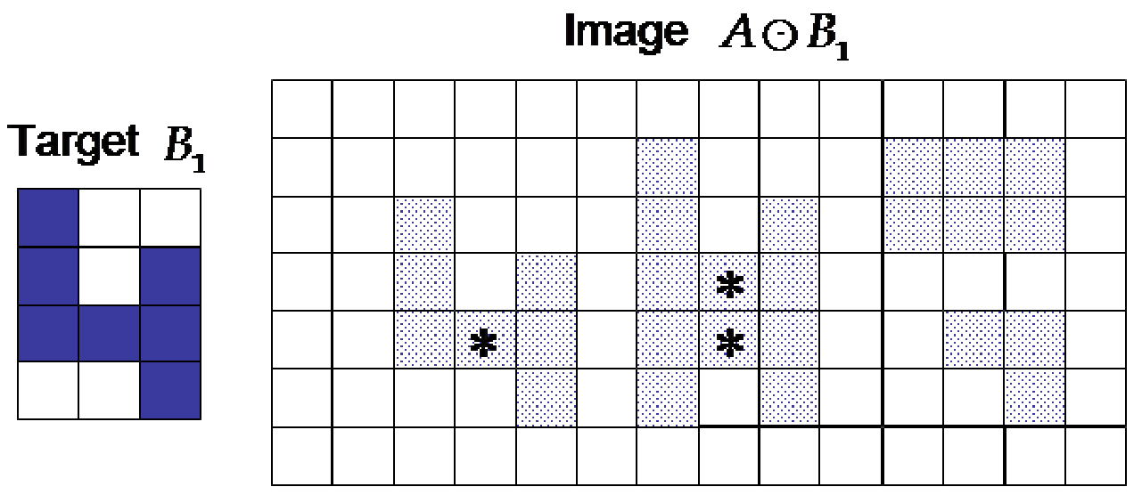
Step 1: erosion with the target → Hits
Notes:
The first step has identified all those points in the image foreground at which the required configuration of foreground pixels in the target may be found (but has ignored the required background configuration).

Slide 11
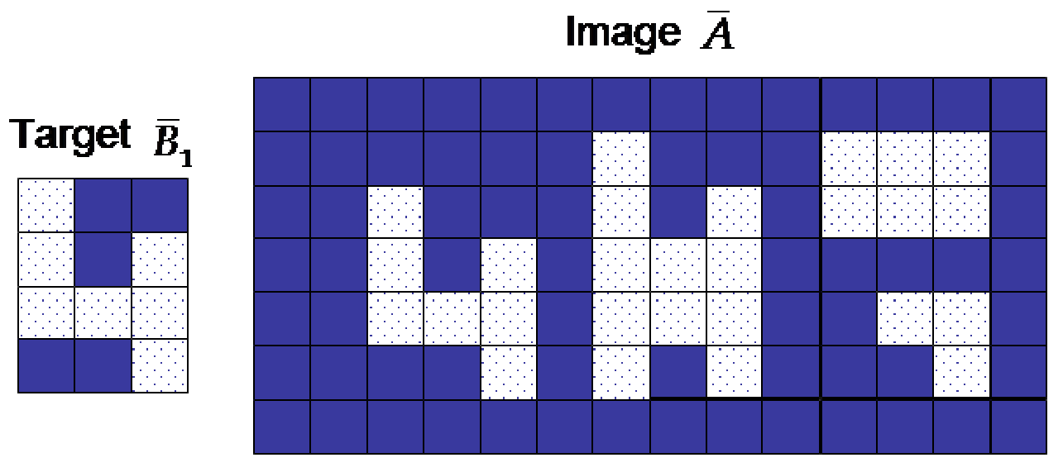
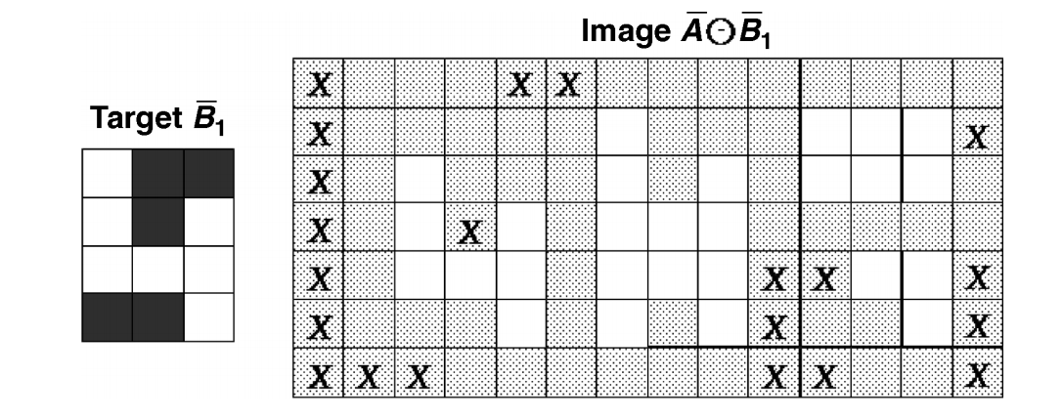
Step 2: erosion with the complement structuring element and complement image→Misses
Notes:
By contrast, the second step has identified all those points in the image background at which the required configuration of background pixels in the target may be found (but has ignored the required foreground configuration).

Slide 12
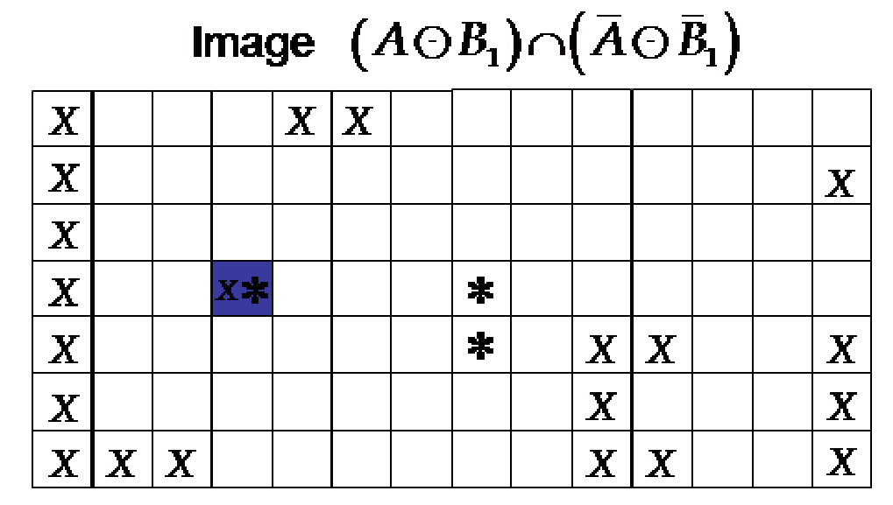
Step 3: Intersection of hits and misses
Notes:
This is a constrained version of hit-or-miss transformation. Very sensitive to noise and exact position of the pixels.

Slide 13
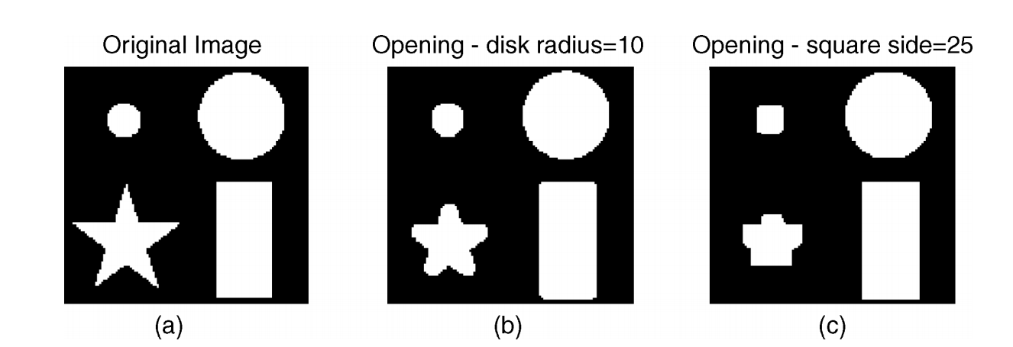
Opening by reconstruction
A method to fully recover the effects of opening operation.
Requires two images: the original binary image (the mask) and the marker (the image obtained after the initial step of erosion).
Mask constrains the marker, never allowing new foreground pixels to appear.
Exercise 2 in the lab
Notes:
One simple but useful effect of morphological opening (erosion followed by dilation) is the removal of small unwanted objects. By choosing a structuring element of a certain size, erosion with this element guarantees the removal of any objects within which that structuring element cannot be contained. The second step of dilation with the same structuring element acts to restore the surviving objects to their original dimensions. However, if we consider an arbitrary shape, opening will not exactly maintain the shape of the primary objects except in the simplest and most fortuitous of cases.

Slide 14
References
Many pictures from this presentation were taken from the book “Fundamentals of digital image processing” by Chris Solomon & Toby Breckon

